Slide 1
4 WEEKS INDUSTRIAL TRAINIG ON ALGORITHMS & LINUX
SUBMITTED TO: SUBMITTED BY:
CSE COORDINATOR Abhishek ranjan
(sg15304)

Slide 2
Multiple Data Compression & Decompression also Encryption Using Iterative Techniques

Slide 3
NEED OF MDC
Basic purpose of this project compress the data which have in text format. But we can compress any type of data if we know code format of that
type data. Exp : image , audio , video etc.
Iterative Technique is used for compression which is Latest and use for bit shifting.
By this project we can compress the data more than 50% .
We can reduce the bandwidth at desired level by this method.
The data transmission is very smooth & fast after compression.
The main advantage of this project Encryption .
Nobody can read your data without Encryption key. The price of Encryption key in Lakhs at industry level .

Slide 4
BLOCK DIAGRAM OF COMPRESSION
CREATE TEXT FILE
OPEN FILE ON FD
READ TEXT FILE ON FD
FIND UNIQUE CHARACTER
COMPRESS FILE BY BIT SHIFTING

Slide 5
WORKING PROCESS
Text file is source of project which have some texts .
The file contains different-different data type some are following:
Char , int.
In char type data means there have only characters and a single character have 8 bits.
A int type data have 4 byte means 32 bit see the diagrams of char data or int type data.
Single character & integer
1. TEXT FILE
0 | 0 | 0 | 0 | 0 | 0 | 0 | 0 | 0 | 0
0 | 0 | 0 | 0 | 0 | 0 | 0 | 0 | 0 | 0 | 0 | 0 | 0 | 0 | 0 | 0 | 0 | 0 | 0 | 0 | 0 | 0 | 0 | 0 | 0 | 0 | 0 | 0 | 0 | 0 | 0 | 0

Slide 6
2. OPEN FILE
After making a text file then open this file in project.
Project is based on Embedded c or linux so the there have use some system calls or c programming.
First of all we use some header files which includes small additional operations for exp:
#include<stdio.h>; includes printf of scanf operation. Every header file start from # which is predefined micro .
Predefined micro symbol is used for handshake with compiler.
Then make a open function & for open file use open system call.
Open(“file name ”, mode of file);

Slide 7
3. READ TEXT FILE
After open the file then we read the file character by character with index of characters.
Command is used for read operation: read(fd ,&buffer/pointer , no. of byte);
Some parameters which are using in this read function are following:
Fd ---file descriptor
Buffer---Array(int/char)
Pointer ----point & hold the address of any type of data.

Slide 8
4. FIND UNIQUE CHARACTERS OF FILE
The text file contains like following characters:
Text file----she sells sea shells on the sea shore.
There have some repeatable characters.
Remove the copy of repeating character and get unique characters.
When remove copy of repeating characters the source file like: FILE BUFFER
s 0
h 1
e 2 comparing file characters with master array
/b 3
l 4
a 5 MASTER ARRAY
h 6 Index of unique characters if(FILE BUFFER != MASTER ARRAY)
o 7 MASTER ARRAY=FILE BUFFER
n 8 0 1 2 3 4 5 6 7 8 9
r 9
s | h | e |  | s | e | l | l | s |  | s | e | a |  | s | h | e | l | l | s |  | o | n |  | t | h | e |  | s | e | a |  | s | h | o | r | e
s | h | e |  | l | a | h | o | n | r

Slide 9
5. FIND UNIQUE INDEX
FILE BUFFER
s | h | e |  | s | e | l | l | s |  | s | e | a |  | s | h | e | l | l | s |  | o | n |  | t | h | e |  | s | e | a |  | s | h | o | r | e
0 | 1 | 2 | 3 | 4 | 5 | 6 | 7 | 8 | 9 | 10 | 11 | 12 | 13 | 14 | 15 | 16 | 17 | 18 | 19 | 20 | 21 | 22 | 23 | 24 | 25 | 26 | 27 | 28 | 29 | 30 | 31 | 32 | 33 | 34 | 35 | 36
Value
index
MASTER ARRAY
s | h | e | /b | l | a | o | n | t | r
0 | 1 | 2 | 3 | 4 | 5 | 6 | 7 | 8 | 9
Value
index
If(value of file buffer==value of master array)
Index of Unique value=master array Index
UNIQUE INDEX
s | h | e |  | s | e | l | l | s |  | s | e | a |  | s | h | e | l | l | s |  | o | n |  | t | h | e |  | s | e | a |  | s | h | o | r | e
0 | 1 | 2 | 3 | 0 | 2 | 4 | 4 | 0 | 3 | 0 | 2 | 5 | 3 | 0 | 1 | 2 | 4 | 4 | 0 | 3 | 6 | 7 | 3 | 8 | 1 | 2 | 3 | 0 | 2 | 5 | 3 | 0 | 1 | 6 | 9 | 2
New Value
New index

Slide 10
6. COMPRESSION
After find the unique index , compression is start.
In compression unique index play main role , because there have file characters with master array index.
unique index
This index is a int type so , firstly typecast it into char type for bit shifting.
Sprintf(char type index,”%d”,unique index)

Slide 11
START COMPRESSION
Now read file again in same fd by single-single character.
Check value in the unique index of first reading character.
We know the 1st character of file is ‘S’ so value of s is in index 0.
0 is code of first character of file which is in 8 bits , because index is typecast in char data type.
See diagram of Snew code
CODE OF S IN 8 BITS
0 | 0 | 0 | 0 | 0 | 0 | 0 | 0
Read again next character of file which is ‘h’ and get new code for h. which is like following:
0 | 0 | 0 | 0 | 0 | 0 | 0 | 1
CODE OF h IN BINARAY FORMAT

Slide 12

BIT SHIFTING/ITERATIVE TECHNIQUE
Now we have first two characters of file. Which are following:
s h
We know the text file contains no. of repeating characters , but we also remove the this and get unique characters which are 10(0-9)
So for bit shifting code length is necessary so we find the cl with these unique characters.
No. of unique characters =10
So , we know 2*2*2*2=16 & 2*2*2=8
8>Unique characters<16
So, cl =4,means we can represent value of single-single character in 4 bits.
0 | 0 | 0 | 0 | 0 | 0 | 0 | 0
0 | 0 | 0 | 0 | 0 | 0 | 0 | 1

Slide 13


0 | 0 | 0 | 0 | 0 | 0 | 0 | 0
Now shift the last four bits of s to left.
value of s in 4 bits padding of s
Code of h-
After shifting left and then right, the code of h representing in 4 bits:
h padding of h
After shifting both characters we do OR between both characters.
See diagram:
s h
0 | 0 | 0 | 0 | 0 | 0 | 0 | 0
0 | 0 | 0 | 1 | 0 | 0 | 0 | 0
0 | 0 | 0 | 0 | 0 | 0 | 0 | 1

Slide 14
WRITE COMPRESS FILE
Now we have a new single byte which having first two characters of file.
We can write this byte in a new file which name is compress file.
We are making single-single byte again & again when the TEXT FILE not reaches at end of file character.
Also store every new byte in Compress file.
Now see comparison between TEXT FILE & COMPRESS FILE
TEXT FILE
COMPRESS FILE
s | h | e |  | s | e | l | l | s |  | s | e | a |  | s | h | e | l | l | s |  | o | n |  | t | h | e |  | s | e | a |  | s | h | o | r | e
^A | ^B | ^C | ^D | ^F | ^E | ^A | @ | ! | & | * | % | $ | ^C | ^X | ^A | # | @ | ^C

Slide 15
ENCRYPTION CODE
After writing the compress file when we see characters , these are like as following:
So nobody can read this file because characters of TEXT FILE are encrypted.
Above diagram shows a compressed file and no. of character are only 18.
But the original file have 36 character that means we do successfully 50% compression.
This is 4 bit compression because file contain only 10 distinct characters if no. of distinct character are
increase and decreases then also possible 2,3,4,5,6,7,(bit) compression

Slide 16
DECOMPRESSION
After compression if want to read original data of then we do decompression.
For decompression we open the Compress file by open system command .
Then we can read this file byte by byte .
Now store the single-single byte in temp char type variable for shifting purpose.
The first byte structure of compressed file like following:
s+h
After store the byte in temp variable shift 4 bit this to right for get code of s.
Then shift the temp variable first left and then right for get code of h.
Then read next byte and do same process ,continue the same process when the compress file not reach at end of file character.
0 | 0 | 0 | 0 | 0 | 0 | 0 | 1

Slide 17
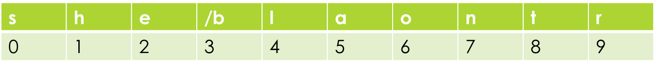
Encryption key
Byte are decompress but we just find the unique index (address)code of original data of file not characters.
So ,for read original file we need encryption key.
Our encryption key is master array which have the distinct characters.
We decompress the code now we print the value of master array with this code.
0 | 1 | 2 | 3 | 0 | 2 | 4 | 4 | 0 | 3 | 0 | 2 | 5 | 3 | 0 | 1 | 2 | 4 | 4 | 0 | 3 | 6 | 7 | 3 | 8 | 1 | 2 | 3 | 0 | 2 | 5 | 3 | 0 | 1 | 6 | 9 | 2

Slide 18
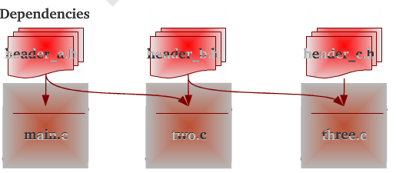
DEPENDENCIES

Slide 19
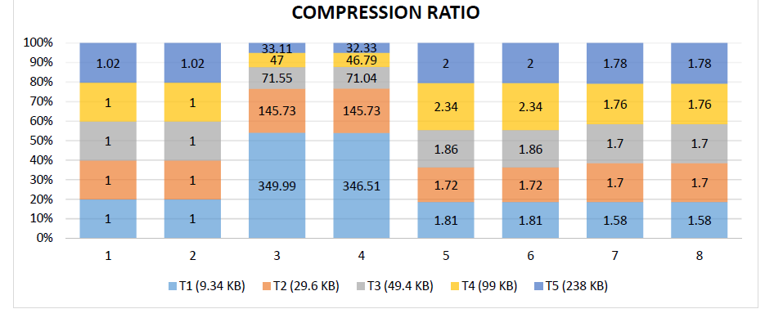
GENERAL RESULT

Slide 20
THANK YOU

